Slide 1

AVIATION MARKETING ANALYTICS
EastWest Airlines Customer Segmentation
Applying Unsupervised Learning to identify high-value flyer personas and optimize loyalty program engagement.

Slide 2
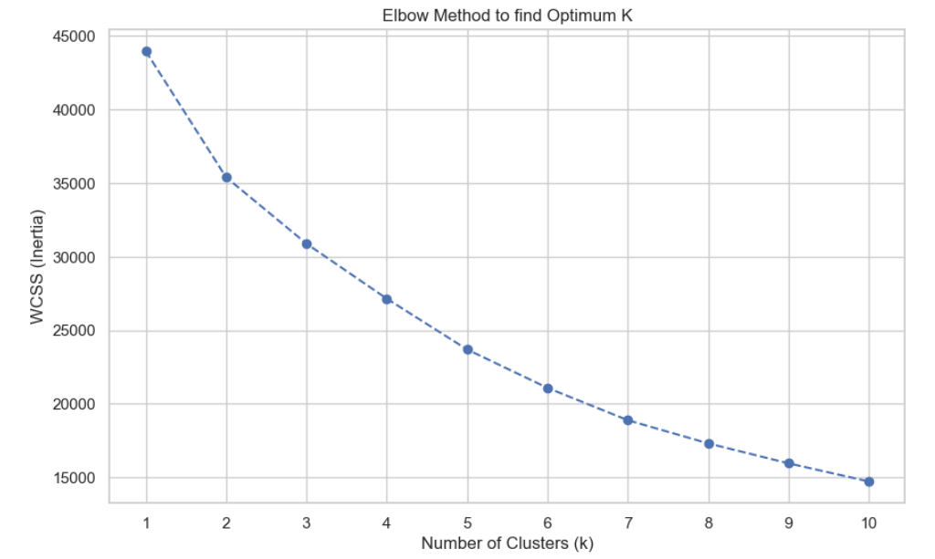

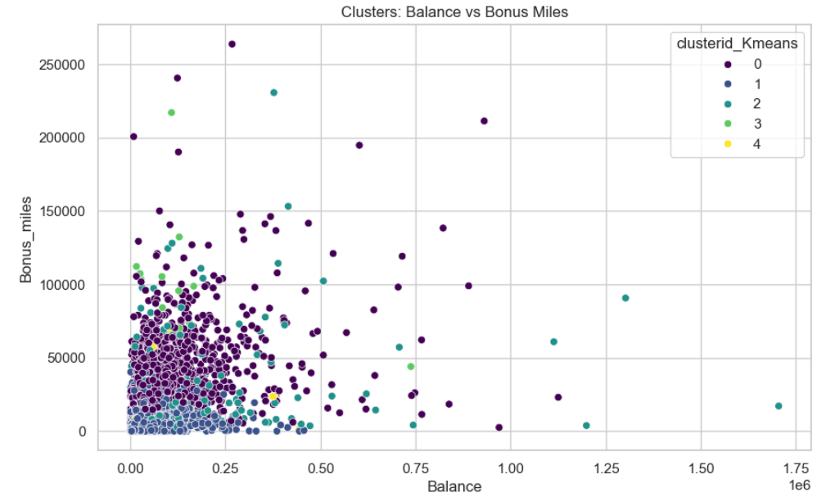
OBJECTIVE & DATASET OVERVIEW
Business Goal
To maximize the efficiency of the EastWest Airlines frequent flyer program by segmenting passengers into clusters based on mileage, credit card usage, and flight frequency. This allows for hyper-personalized marketing offers.
Dataset: 3,999 records, 12 variables (Balance, Bonus_miles, Flight_miles, CC_miles, etc.)

Slide 3


STRATEGIC CORE SEGMENTS
Cluster 1
Cluster 2
Cluster 0 & 3
Cluster 4
THE BULK (LOW VALUE)
THE VIP FLYERS
CARD LOYALISTS
REWARDS USERS
Target with "First Flight" discounts to build loyalty.
Priority service & lounge access for elite members.
Double-point weekends via retail partners.
Specialized card-holder insurance & events.
Segment Inference
By moving away from "one-size-fits-all" marketing, the airline can significantly reduce churn in the "Bulk" segment while increasing the "wallet-share" of the Card Loyalists through high-engagement retail partnerships.

Slide 4


PROJECT CONCLUSION
Model Performance
Successfully segmented the population into 5 distinct, actionable clusters with high intra-cluster similarity, validated via the Elbow method.
Key Takeaway
Credit card integration is the primary driver for miles accumulation outside of flying. Transitioning "Bulk" users to "Card Loyalists" is the highest ROI path.
Next Steps
Integrate churn probability scores and customer lifetime value (CLV) predictions to further refine the targeting of the VIP and Reward segments.

